Slide 1
Functions

Slide 2
What is Functions?
Reusable blocks of code designed to perform a specific, isolated task.
“Like a recipe abstracts cooking steps, a function abstracts code logic.”
WHY USE THEM?
1
2
3
Modularity
Readability
Maintenance
Execute tasks multiple times without duplicating instructions.
Break complex logic into smaller, understandable chunks.
Update logic in one place to affect all occurrences.

Slide 3
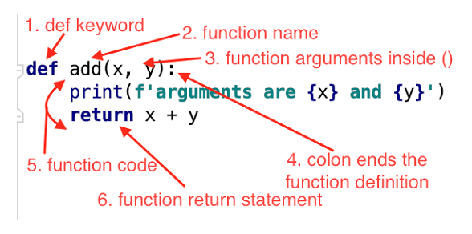
Anatomy of a Function
Understanding the Syntax
1. def keyword: Marks the start of a function header.
2. Function Name: A unique identifier to call the function.
3. Arguments: Inputs passed into the function inside ().
4. Colon (:): Signal the end of the function header.
5. Function Code: The block of logic that performs the task.
6. Return Statement: Exits the function and passes back a value.

Slide 4
Define and Call a Function

Slide 5
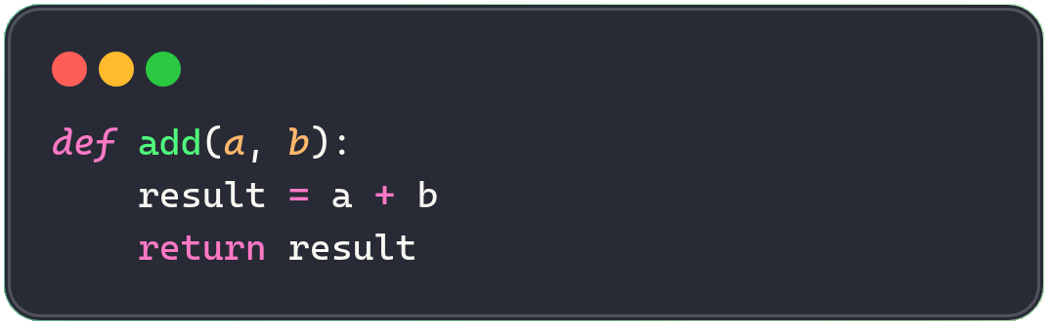
Define a Function with def
1. Write def and name your function
2. Indent 4 or 2 spaces (must stay consistent), then write the body
3. Use return to send back a value (Optional)

Slide 6
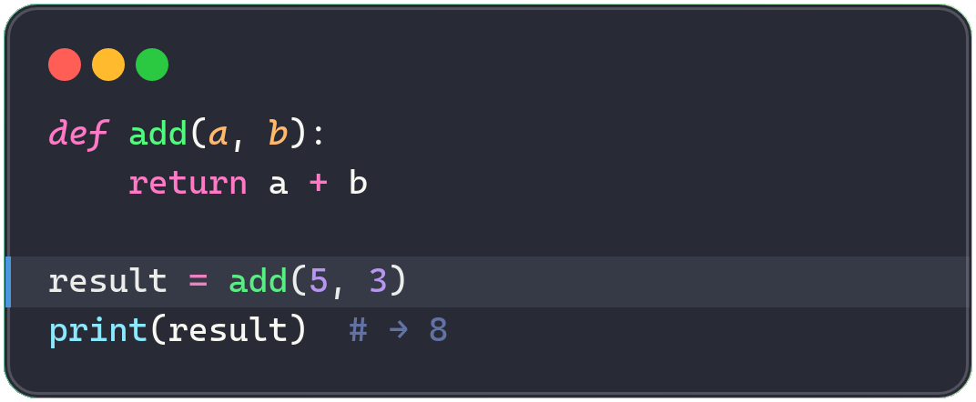
USING FUNCTIONS
Calling a Function
DEFINE
Use the function name + parentheses with arguments to run it.
Insight: the values you pass in (5, 3) are matched to (a, b) in order.
5

Slide 7
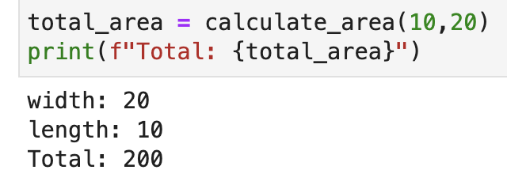
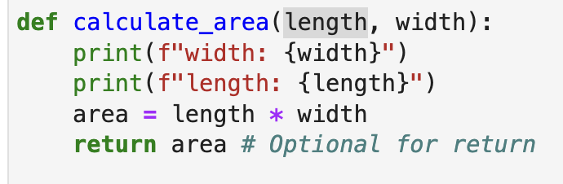
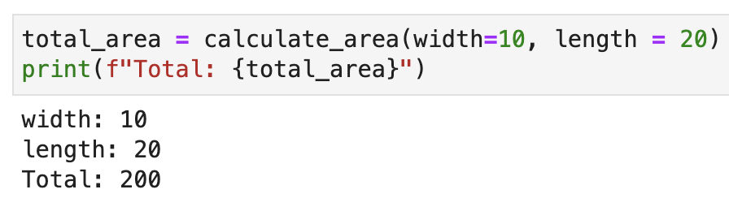
Function definition
Invoke/call the function by name
or

Slide 8
Function with and without return

Slide 9
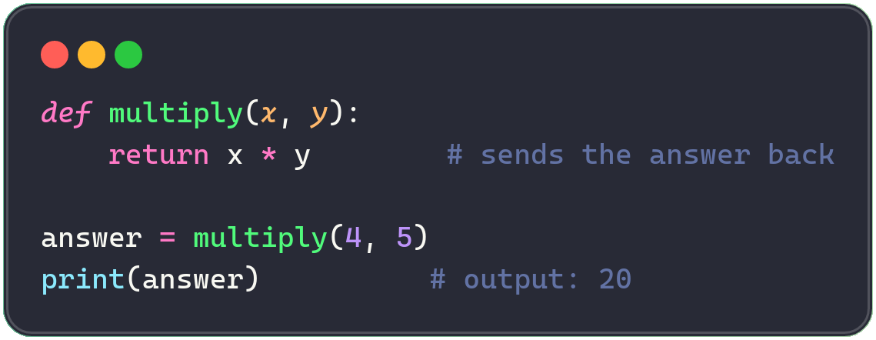
Functions Can Return Values
return sends a result back to the caller.
EXAMPLE OUTPUT
multiply(4, 5)
→ 20
Insight: a function without return gives back None by default.

Slide 10
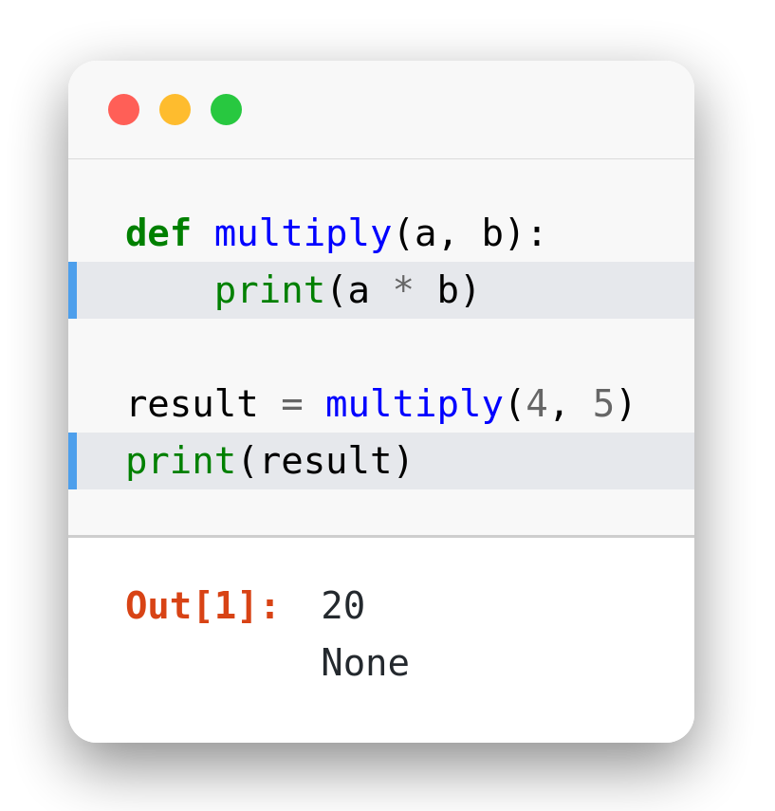
Not the Same Thing
PRINT VS RETURN
Why it matters
print() displays a value on screen — for humans, not the program
return sends the value back so it can be stored, passed along, or computed with
Here, multiply() only prints — the caller's result ends up None
Highlighted: the print() inside the function, and result used outside
● Caution: 20 appears on screen, but result is still None — multiply() never returned anything.
Notes:
def multiply(a, b):
print(a * b)
result = multiply(4, 5)
print(result)
# prints: 20
# prints: None

Slide 11
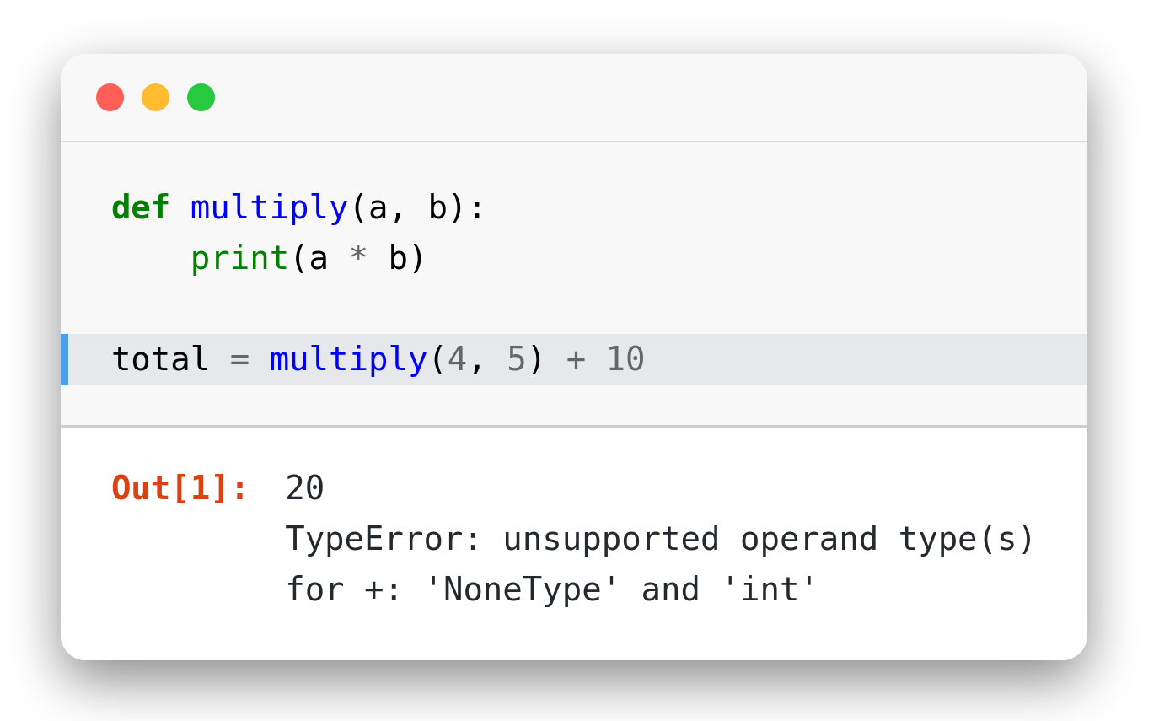
Using a None Result
COMMON MISTAKE
What goes wrong
multiply() still only prints — it never returns
total = multiply(4, 5) + 10 tries to add None + 10
Python raises a TypeError because None isn't a number
Highlighted: the line that fails
● Caution: if you plan to use a function's result later, it must return it — not just print it.
Notes:
def multiply(a, b):
print(a * b)
total = multiply(4, 5) + 10
# TypeError: unsupported operand type(s) for +: 'NoneType' and 'int'

Slide 12
Lambda Function

Slide 13

Lambda Function
Functions that don’t need to be named, defined without the standard def keyword.
1
2
Anonymous Identity
Efficient One-Liners
No name is required — the function exists just long enough to be used, often passed directly as an argument.
Ideal for small operations where a full def block would be overkill for a simple, single-expression task.

Slide 14
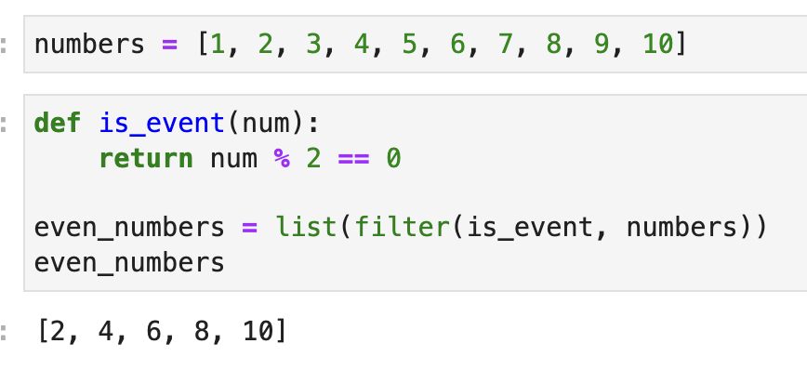
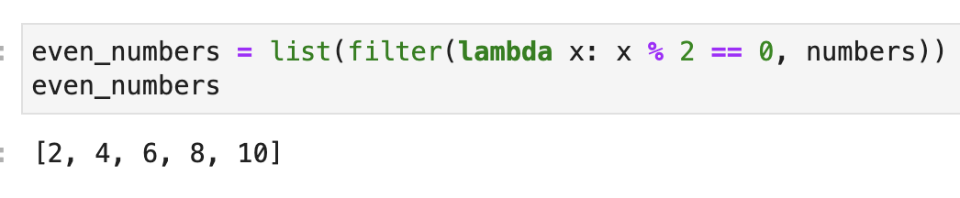
Find event number using Function
Find event number using Lambda

Slide 15
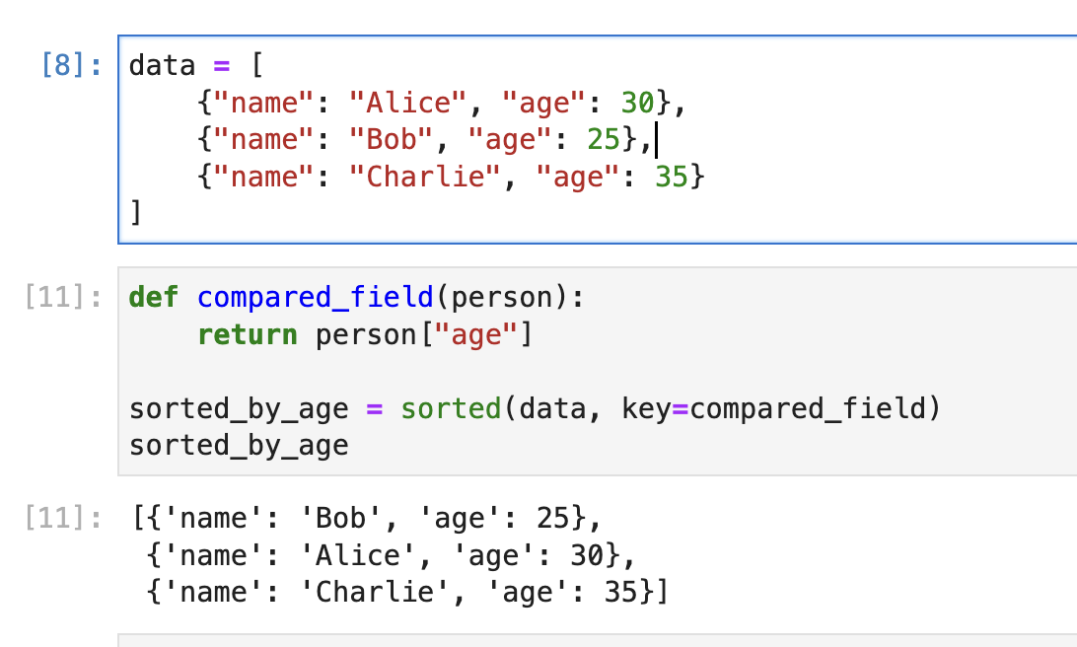
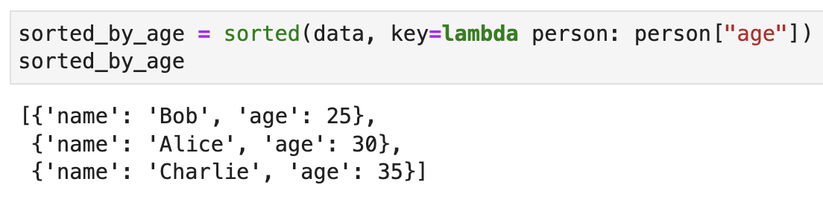
Sort by field using Function
Sort by field using Lambda

Slide 16
Exerciese

Slide 17
Level 1: Beginner
DEFINITIONS · INVOCATION · PRINT VS RETURN
Understanding function headers, basic parameters, and how return values work vs printing.

Slide 18
Exercise 1: Simple Greeting
greet.py
Your task
def greet_user(name):
# your code here
pass
# call it twice with different names
Goal: practice function syntax and parameter passing.
Write `greet_user(name)` that prints:
"Hello, <name>! Welcome to Python."
Call the function twice with different names.
Expected output:
[1] greet_user("Amy") → output: "Hello, Amy! Welcome to Python."
[2] greet_user("Liam") → output: "Hello, Liam! Welcome to Python."
Notes:
def greet_user(name):
print(f"Hello, {name}! Welcome to Python.")
greet_user("Amy")
greet_user("Liam")

Slide 19
Exercise 2: Area Calculator
area.py
Your task
def calculate_rectangle_area(width, height):
# your code here
pass
area = calculate_rectangle_area(4, 5)
print(area * 2)
Goal: tell the difference between printing and returning values.
Write `calculate_rectangle_area(width, height)` that returns the area.
Assign the result to `area`, then print `area * 2`.
Expected output:
[1] width=4, height=5 → output: 40
[2] width=3, height=6 → output: 36
Notes:
def calculate_rectangle_area(width, height):
return width * height
area = calculate_rectangle_area(4, 5)
print(area * 2) # 40

Slide 20
Exercise 3: Fix the NoneType Bug
tax.py
Your task
def add_tax(price):
print(price * 1.1)
total = add_tax(100) + 5 # Currently fails!
Goal: recognize and fix a `TypeError` caused by a missing `return`.
`add_tax()` currently prints instead of returning a value.
Fix the function so `total` calculates correctly.
Expected output:
[1] add_tax(100) + 5 → return: 115.0
[2] add_tax(50) + 5 → return: 60.0
Notes:
def add_tax(price):
return price * 1.1
total = add_tax(100) + 5 # 115.0

Slide 21
Exercise 4: Even/Odd Checker
even_odd.py
Your task
def is_even(number):
# your code here
pass
print(is_even(7))
print(is_even(12))
Goal: use control flow inside a function.
Write `is_even(number)` that returns True if even, False if odd.
Test it with `7` and `12`.
Expected output:
[1] is_even(7) → return: False
[2] is_even(12) → return: True
Notes:
def is_even(number):
return number % 2 == 0
print(is_even(7)) # False
print(is_even(12)) # True

Slide 22
Level 2: Intermediate
MULTI-PARAMETER FUNCTIONS · LAMBDAS
Handling multiple inputs, using default values, and writing basic inline anonymous functions.

Slide 23
Exercise 5: Format Full Names
full_name.py
Your task
def format_full_name(first_name, last_name, middle_name=""):
# your code here
pass
Goal: handle multiple positional arguments and a default value cleanly.
Return a clean full-name string from `first_name`, `last_name`, and an optional `middle_name`.
Test it with and without a middle name.
Expected output:
[1] format_full_name("Ana","Lee") → return: "Ana Lee"
[2] format_full_name("Ana","Lee","J") → return: "Ana J Lee"
Notes:
def format_full_name(first_name, last_name, middle_name=""):
if middle_name:
return f"{first_name} {middle_name} {last_name}"
return f"{first_name} {last_name}"
print(format_full_name("Ana", "Lee")) # Ana Lee
print(format_full_name("Ana", "Lee", "J")) # Ana J Lee

Slide 24
Exercise 6: Def to Lambda
square.py
Your task
def square(x):
return x ** 2
Goal: convert a standard `def` function into a concise `lambda`.
Rewrite `square(x)` above as a single-line lambda assigned to a variable named `square`.
Expected output:
[1] square(5) → return: 25
[2] square(9) → return: 81
Notes:
square = lambda x: x ** 2
print(square(5)) # 25
print(square(9)) # 81

Slide 25
Exercise 7: Filter Even Numbers
evens.py
Your task
numbers = [1, 2, 3, 4, 5, 6, 7, 8, 9, 10]
# your code here
Goal: use lambdas for quick, inline evaluation.
Given the list above, use a lambda inside `filter()` (or a list comprehension) to keep only the even numbers.
Expected output:
[1] numbers = [1..10] → return: [2, 4, 6, 8, 10]
Notes:
numbers = [1, 2, 3, 4, 5, 6, 7, 8, 9, 10]
evens = list(filter(lambda n: n % 2 == 0, numbers))
print(evens) # [2, 4, 6, 8, 10]

Slide 26
Exercise 8: Discount Calculator
discount.py
Your task
def apply_discount(price, discount_percent=10):
# your code here
pass
Goal: master optional parameters and default return behavior.
Return the discounted price from `price` and `discount_percent` (default 10).
Call it with just `price`, then override the discount with `20`.
Expected output:
[1] apply_discount(100) → return: 90.0
[2] apply_discount(100, 20) → return: 80.0
Notes:
def apply_discount(price, discount_percent=10):
return price * (1 - discount_percent / 100)
print(apply_discount(100)) # 90.0
print(apply_discount(100, 20)) # 80.0

Slide 27
Level 3: Advanced
SORTING · COMPOSITION · LOGIC ABSTRACTION
Sorting complex data structures using key functions, chaining functions, and logic abstraction.

Slide 28
Exercise 9: Sort Students by Score
students.py
Your task
students = [
{"name": "Alice", "score": 88},
{"name": "Bob", "score": 95},
{"name": "Charlie", "score": 78}
]
# your code here
Goal: use lambdas as key functions for sorting complex data.
Sort `students` in descending order by `"score"` using `sorted()` and a lambda key.
Expected output:
[1] sorted by score, descending → return: [Bob 95, Alice 88, Charlie 78]
Notes:
students = [
{"name": "Alice", "score": 88},
{"name": "Bob", "score": 95},
{"name": "Charlie", "score": 78}
]
ranked = sorted(students, key=lambda s: s["score"], reverse=True)
print(ranked)
# [{'name': 'Bob', 'score': 95}, {'name': 'Alice', 'score': 88}, {'name': 'Charlie', 'score': 78}]

Slide 29
Exercise 10: Multi-Key Sort
sort_multi.py
Your task
data = [("Alice", 25, 90), ("Bob", 20, 95), ("Charlie", 25, 85)]
# your code here
Goal: sort by multiple attributes using a tuple key in `lambda`.
Sort `data` primarily by age (ascending) and secondarily by score (descending) — using a single `lambda`.
Expected output:
[1] sorted by age asc, score desc → return: [Bob, Alice, Charlie]
Notes:
data = [("Alice", 25, 90), ("Bob", 20, 95), ("Charlie", 25, 85)]
ranked = sorted(data, key=lambda t: (t[1], -t[2]))
print(ranked)
# [('Bob', 20, 95), ('Alice', 25, 90), ('Charlie', 25, 85)]

Slide 30
Exercise 11: Function Pipeline
pipeline.py
Your task
def clean_text(text):
# your code here
pass
def count_words(text):
# your code here
pass
def process_document(raw_text):
# your code here
pass
Goal: combine functions where one's return value feeds the next.
`clean_text(text)` → strips whitespace, lowercases.
`count_words(text)` → returns word count.
`process_document(raw_text)` → calls `clean_text`, then `count_words`.
Expected output:
[1] process_document(" Hello WORLD ") → return: 2
Notes:
def clean_text(text):
return text.strip().lower()
def count_words(text):
return len(text.split())
def process_document(raw_text):
return count_words(clean_text(raw_text))
print(process_document(" Hello WORLD ")) # 2

Slide 31
Extra Learning resource
https://code.tutsplus.com/introduction-to-python--CRS-200307c
https://code.tutsplus.com/data-handling-with-python--CRS-200572c
https://gto76.github.io/python-cheatsheet/

